Slide 1
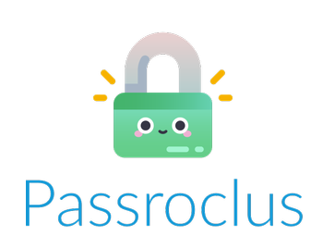

Coderona
Stuart Brown, Peter Captain, Tia Cotton, Catriona Kirkwood, Roderick Rozalina
20th April 2021
Abertay University, Dundee
Notes:
Hello and welcome to the Coderona presentation of the Passroclus password tool. I’d like to introduce the team; Stuart Brown, Peter Captain, Tia Cotton, myself, Catriona Kirkwood and Roderick Rozalina.

Slide 2
Presentation Outline
Project Brief
Background
Methodology
Results & Conclusions
Client Brief Expectations
Overall Reflection
Notes:
Today we will present an overview of the Passroclus product including details of the project brief, the background to the problem, the methodology implemented, results and conclusions of the product, an evaluation of the client brief expectations, and an overall reflection of the product.

Slide 3



Project Brief Dr. Ethan Bayne, Abertay University
Public lacks knowledge on password creation
Create a tool which:
Checks password strength
Checks if password has been breached
Educates on password best practices
Aims to promote the use of more secure passwords and increase knowledge on strong password creation
Notes:
In late 2020 Dr Ethan Bayne of Abertay University contacted Coderona to develop a password tool to address the lack of public knowledge in the area of cyber security and password creation. This was to take the form of a browser utility, application and/or website. The tool was intended to analyse a password entered by the user and provide feedback on its strength, whether it was known to have been compromised, and to educate the user on password best practices. It was important to the client that the tool handled data securely and locally and that it was intuitive and easy to use. The aim was to increase cyber security awareness for users of the university system, promote the use of stronger passwords, and create a better defence against brute force attacks.

Slide 4
Background Problem Statement
Cyber-attacks on UK businesses reached a record high in Q1 of 2021
Scottish universities and colleges have recently been targeted
Strong passwords are the first line of defence
Benefit to client is that user passwords will be more difficult to crack
Notes:
Earlier this month, Beaming reported that cyber-attacks on UK businesses reached a record high in the first quarter of 2021, continuing the trend seen in previous years. Recent attacks on Scottish universities and colleges have had a damaging impact and it is therefore important that Abertay University takes steps to minimise its vulnerability to cyber-attacks as much as possible. The first line of defence against such attacks is ensuring users use strong and secure passwords which are difficult to crack using brute force techniques. Coderona’s Passroclus tool benefits the client by addressing the problem of insufficient password creation knowledge among the general public. This should ensure that users of Abertay University systems use passwords that are better protected from brute force attacks, which is important given the high level of cyber-attacks in the education sector.

Slide 5
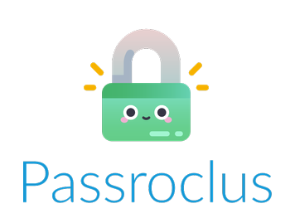
What is Passroclus?
All-in-one tool for passwords
Educates and helps users develop secure passwords
Web application and browser add-on for client
Notes:
Passroclus is an all-in-one tool that checks the strength of a password entered by the user and provides feedback on that password. Additionally it checks whether the password has previously been breached and provides the user the ability to generate a new, strong password. It also educates the user on current password best practice and helps them to understand the importance of strong password creation. Passroclus was created in the form of a web application and browser add on to ensure that it is accessible to all potential users, it also handles data securely. Next Tia will discuss the methodology used.

Slide 6

Methodology - Overview
Passroclus makes use of a lightweight API
Passroclus API has a web application built onto the top of it for easy use.
The passroclus browser add-on uses the web application.
Notes:
Thanks Catriona, I’ll be covering the methodology of the prototype.
Overall the current Passroclus prototype has been created on a flask API, which has an easy to use web application built on top of it, which the browser add-on also makes use of.

Slide 7



Technologies Used
Flask
API built using python on a Flask Framework
HTML/CSS used in Web Application/Add-on
Heroku
Hosts Passroclus on the cloud
GitHub
Hosts the Passroclus repository
Allows for version control and more accessibility
Notes:
The Passroclus application is a python based API, which has been built upon the Flask framework. This also allowed for the web application to be built on top of the API rather than have them separately. Which has worked out to be more effective in both a user and developer point of view.
Heroku is a container based platform which allows Coderona to host and manage Passroclus from the cloud. This made it easier to manage and develop the application.
As it’s hosted on Heroku, Coderona were able to create a github repository to develop the application. The code and resources are located within the repository on GitHub, which Heroku builds and deploys on their platform. Since github allows for version control, this meant that if anything went or does go seriously wrong, it can be reverted back to it’s last working version. GitHub also allowed for more co-operative working between members.

Slide 8
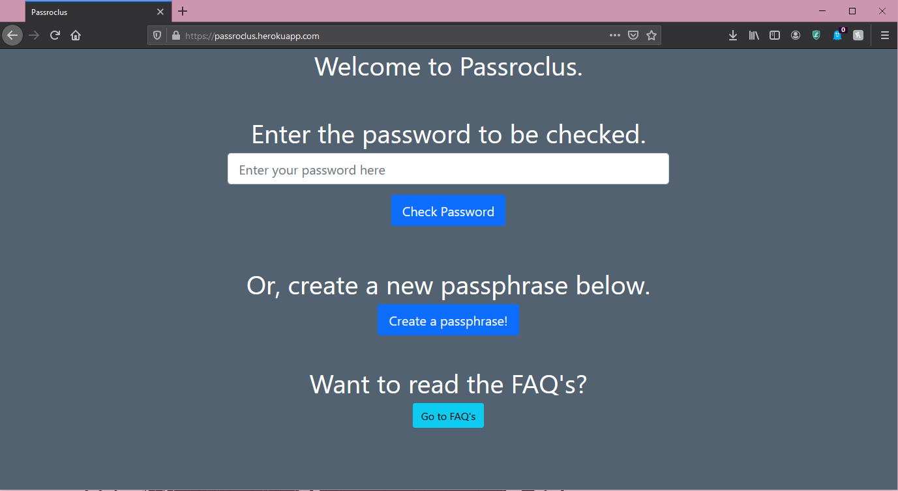
Passroclus Website
Prototype appearance is subject to change, functions will remain.
Two main functions, passphrase generator and strength checker.
FAQ’s containing information about Passroclus.
Notes:
Passroclus’ web application is currently a simple prototype and is subject to change, so the content shown in the screenshots may change appearance in the final version. The web application is fully responsive and can be used on any device. It has two main functions, one is a password checker and the other is a passphrase creator. There is also an FAQ’s page for user’s to learn more about Passroclus and better password hygiene.

Slide 9
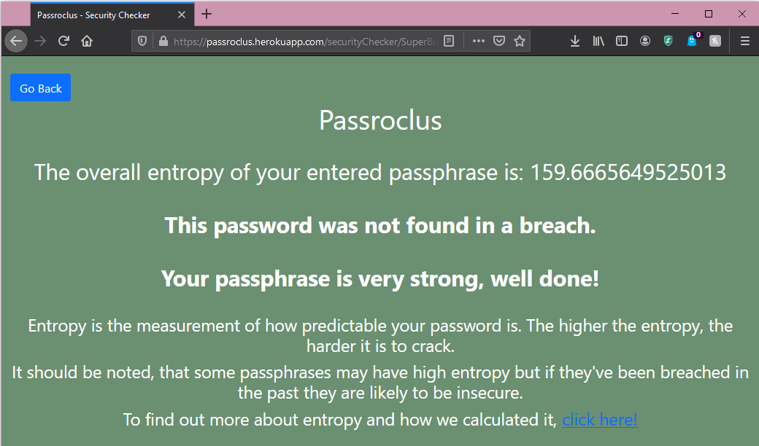
Strength Checker
Calculates the overall entropy of the entered password/phrase.
If the password has been breached, the user is urged to change it.
Traffic light system is in place to emphasise the security of the entered pass.
Notes:
The strength checker calculates the entropy of the entered password. This gives the user a better understanding of how secure their password is rather than counting how many upper and lower case characters, symbols and number are in the password.
There is a brief explanation of what entropy is underneath and a more comprehensive answer within the FAQ’s
If a user’s password has already been breached or is in a wordlist, their password is insecure. The current testing word list that Passroclus uses, it the national cyber security centre’s top hundred thousand passwords. If the user’s password is in the list, they are urged to change it.
To emphasise the strength of the entered password, Coderona have implemented a traffic light system within the background of the strength checker.

Slide 10
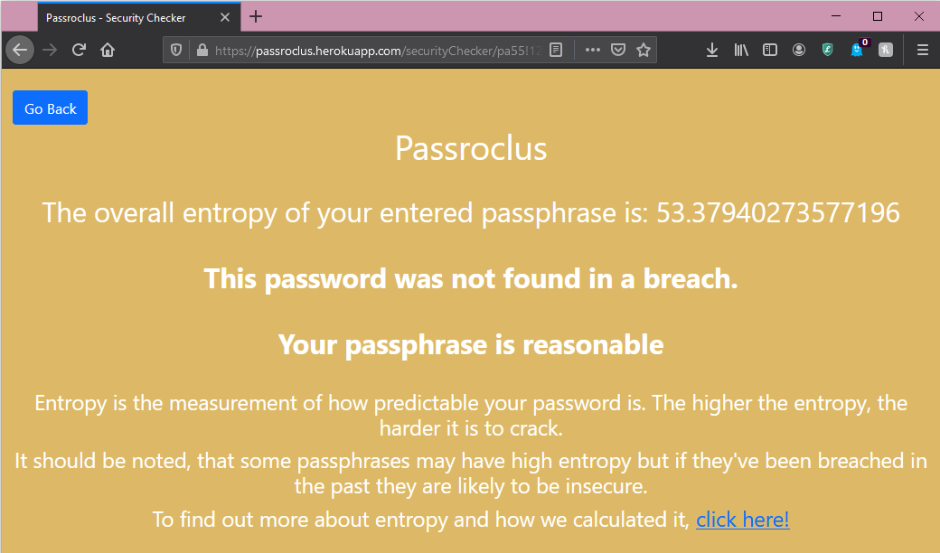
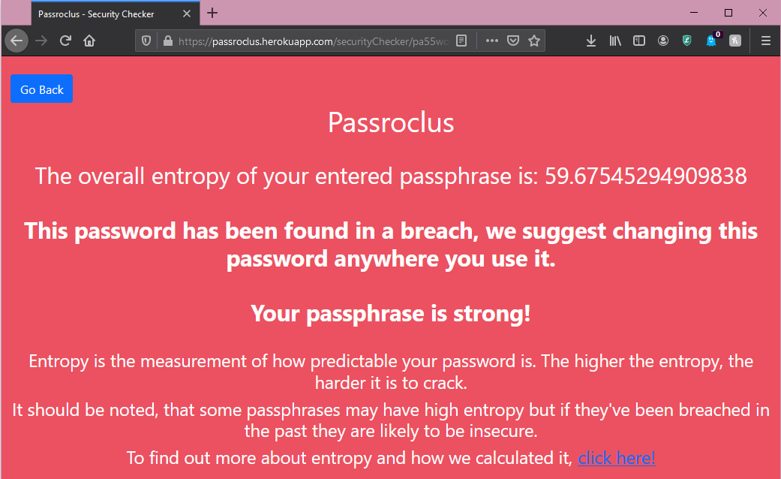
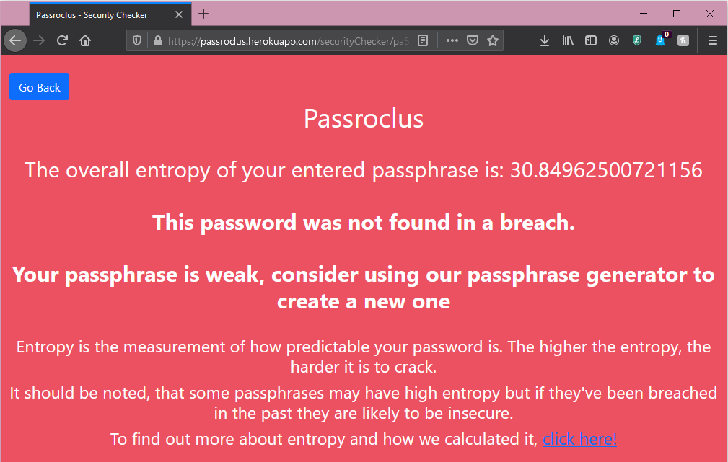
Traffic light colours are used to indicate strength and quality.
Strong, Very Strong = Green
Reasonable = Amber
Very Weak, Weak = Red
Breached Pass = Red
Notes:
Dependant on the entropy score and if the password has been breached, the colour will change.
If the password is not on the breach list, it will be green for Very strong and strong scores, amber for reasonable scores and red for weak and very weak scores.
If the password has been breached at all, the background will be red – no matter how high the entropy score is.
Dependant on the outcome, the user will then be asked if they would like to create a new passphrase using the built in passphrase generator.

Slide 11
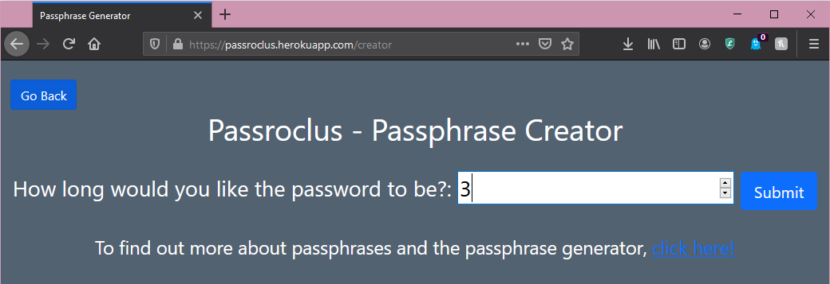
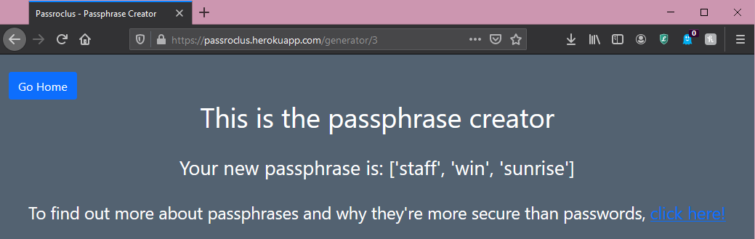
Passphrase Generator
User enters number of words required in the passphrase.
User is able to request a passphrase between 2-6 words long.
Passroclus has a dictionary of ~2500 words.
Notes:
The passphrase generator allows the user to enter a certain number of words they would like to have in their passphrase. The user must enter a value between two and six, this is to ensure that the passphrase is not just a single word, or too long and complicated to remember.
Generator will randomly grab the required number of words from a text file in the server, that contains around two thousand five hundred English dictionary words and display this as a passphrase. Users are able to use these passphrases as they are, or can modify them to include upper case characters, symbols and numbers as required by some password policies.

Slide 12
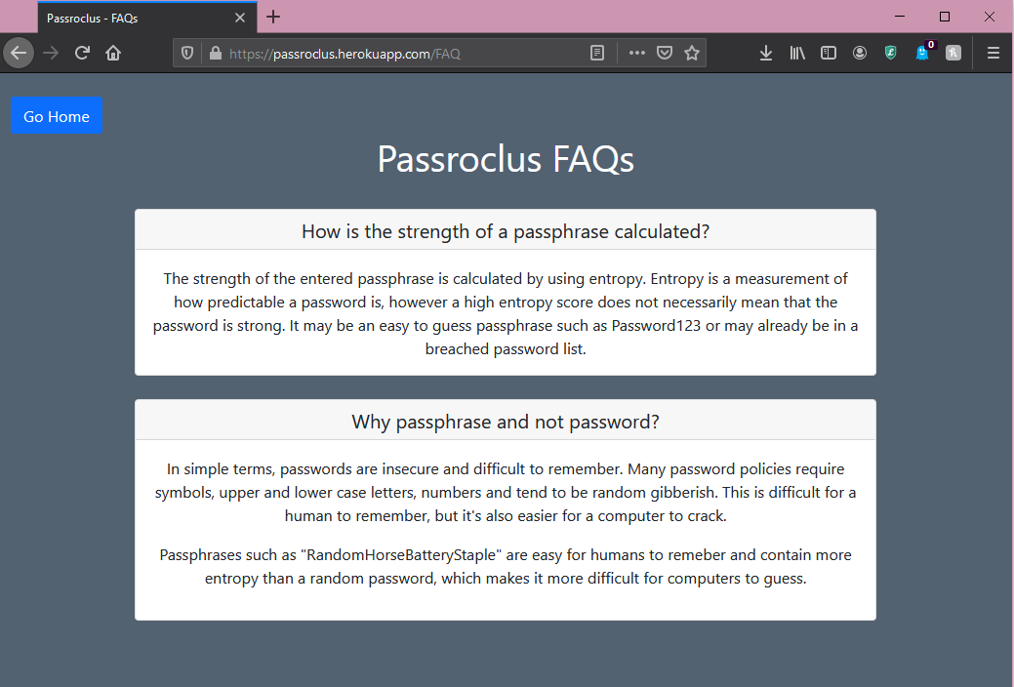
FAQs
The FAQs provide more insight to Passroclus
Can be customised in the final product
Notes:
The FAQs have been added to provide more context to the functions and actions of Passroclus. More answers can be added as required and as the application is being used by the client.

Slide 13
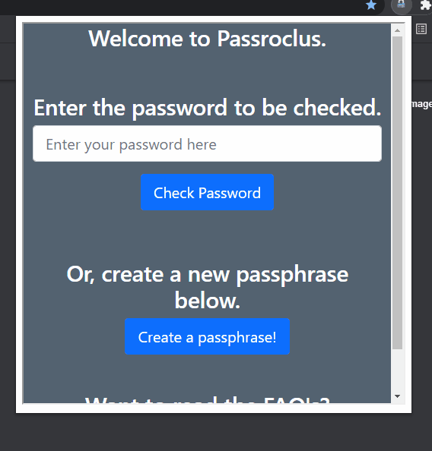
Browser Add-On
The browser add-on displays the web application in an easy to use format.
The user simply clicks the logo and uses the application as normal.
Notes:
The browser add-on uses the web application and displays it as a browser add-on activity. This was chosen as it means that the user doesn’t have to learn how to use the web application and the add-on and provides a seamless transition between both.
It also means that when the web application is updated and deployed, the browser add-on is also updated and deployed.
That’s the current prototype of the Passroclus application and I’ll now pass you over to my colleague, Roderick who will tell you about our results and conclusions.

Slide 14
Results
•Coderona created an all-in-one solution
•Web app accessible on all platforms and devices
•Browser add-on currently only works on Chrome and Edge
•Prototype is fully functional, but appearance is subject to change
•Meets education requirements, in an easy and understandable way
Notes:
Version 2.
>Coderona developed an all-in-one solution that aids in better password and hygiene creation. Users are educated with feedback regarding password strengths and proper password habits to develop.
>Passroclus is accessible on all platforms and devices. The browser add-on currently works on Google and Edge but can be further developed for browsers such as Firefox and Opera.
>The current prototype is subjected to change in terms of appearance and accessibility.
Passroclus tests the strength and the quality of passwords that are entered as well as providing the ability to make a secure passphrase
>Passroclus provides ease-of use to all users and was build with data handling security in mind.
>Recommended updates are certain with regards to breach updates and further product recommendations that advances the functionalities than can be implemented in the future.
Passroclus is an educational tool, which provides users with an easy and digestible way to learn about secure passwords

Slide 15
Conclusions
Implemented features based on research and statistics.
Created a solution that met the client's requirements.
Such as usability, security and protection mechanisms
New features can be easily implemented and improved based on newly acquired information, technology and user feedback.
Feedback examples to the "traffic light" implementation
Notes:
Version 1.0 (Subject to change if needed)
Passroclus was created based on extensive research into the current security trends and implemented features based on the requirements of the client. By analyzing limitations from modern web applications, we've developed an API that is versatile and can meet password criteria requirements so that users can apply their passwords where needed. We've ensured that our product provides educational feedback to users with help of an informative user interface and into developing stronger password habits.
This enables the use of Passroclus’ breach checking functionality from any device with a browser, which is simple to use. Passroclus compares the given password to a list drawn from the database to determine if it has been breached, whilst more technical checks are performed through the Passroclus API.
As this is just the prototype, its application can be improved based on new information on current trends and technology, breaches etc. More secure methods will continue to be applied, alongside feedback from users will continue to aid in the development of the product. >This feedback must be universally understood, as such, this is demonstrated by our “traffic light” background colouring which is altered depending on what feedback is fed back by the add-on.<
(Pass over to Peter.)

Slide 16
Client Expectations
Coderona’s solution aims to fulfil the following expectations:
Feedback on the strengths and weaknesses of a supplied password
Friendly and useful hints on how to improve password
Educational aspects
Useability aspects
Protection from attacks
Dynamic projections (going forward)
Notes:
Peter Captain
Slide 1 –
Thank you Roderick,
Hello my name is Peter Captain
and I am going to talk about the client expectations.
we, the Coderona team have developed Passroclus so as to meet the following expectations, in response to the proposal presented to Dr. Ethan Bayne of Abertay university,
Passroclus will Provide feedback as to the strengths and weaknesses of a supplied password and it will provide friendly and useful hints as to how to improve it.
Educational Aspects
Useability Aspects
Protection from Attacks
As well as the Dynamic Projections (going forward)

Slide 17
Educational Aspect
Improve public knowledge of secure passwords and computer security in general.
Passroclus educates user to dangers of poor password hygiene by displaying hints to how password can be improved
Passroclus provides feedback as to what aspects of the password are poor and how this affects the password performance against attacks.
Notes:
Slide 2
The educational Aspect of Passroclus is an important one.
The best defence against cyber-attacks is to have knowledge as to how to stop them.
Passroclus aims to educate its users as to aspects of password security through use of
the website and browser add-ons we have created
These utilities are where users can safely,
“that is without the password being saved or sent anywhere”,
enter their password for several checks by the utilities we have developed before they submit it to a service
The utilities we have developed as part of Passroclus check several aspects of the password and feedback on what is positive and negative about the password, in order to create constructive advice to send back to the user…

Slide 18
Wide and Easy Useability
Provide an all-in-one utility for users to stay safe online
Easy to understand material to educate user about breaches and password security, in turn helps user create stronger passphrase
Passroclus contains a regularly updated list of breached passwords
Browser add-on is developed for Chromium based browsers
Notes:
Slide 3
Just as important is the usability and accessibility of these functionalities.
Passroclus will respond to a users query with useful and easy to understand form of feedback as to how to improve it.
By doing so, the user can avoid a previously breached password and help themselves achieve a better password or passphrase.
Passroclus also makes use of a list of breached passwords which are stored on a regularly updated browser.
Passroclus calls on this to help assess the password that was entered. This makes the API more lightweight, as it does not carry this list with it.
Passroclus can be deployed on Chromium systems such as Microsoft Edge and Google Chrome, allowing more users to make use of it.

Slide 19
Protection and Deterrence
Reduce number of people falling victim to cyber-related crime
Passroclus will improve the overall strength of the users password
Strength Checking
Breach Checking
Random Generation of Passphrases
Help deter and defeat techniques used by attackers by “levelling up” aspects of the users password such as:
Previous Breach Avoidance
Entropy
Integrity
Memorability
Notes:
Slide 4
Passroclus also aims to deter would be attackers and protect the user.
Passroclus helps the user achieve a stronger password by offering use of numerous functionalities we the Coderona team have produced. These include our
----
Strength Checking
Breach Checking
as well as the Randomly Generated Passphrase functionalities
----
By making use of these functionalities, Passroclus will “level up” aspects of the password presented by the user to the point where an attacker may decide not to attack the password related systems and hopefully deter them from doing so again.
Aspects that are Levelled up include:
----
Prior Breach Detection and Avoidance
As well as the Entropy
Integrity
and Memorability aspects of the supplied password

Slide 20
Dynamic Projections
Create an updated and dynamic solution that will adapt to everchanging guidance
Breach list will be regularly updated when new information is available.
Users are able to learn about and benefit from strong passwords and good password hygiene
Notes:
Slide 5
Coderona has recognised that the current threat environment is a constantly evolving and changing place. The reliance on passwords to protect users accounts will always remain a top concern
The best way to reduce password related attacks is to keep on top of password security itself as well as keep it up to date
----
As such; by maintaining a server which will be kept updated with information such as commonly breached passwords this will allow Passro clus to help prevent users from accidentally using such a password as their own.
----
Coderona has equipped the Passro clus API with access to this server to provide up to date protection from brute force style attacks.
By doing these checks and making use of Passroclus’ utilities it is therefore possible for a user to achieve a strong password that will protect them from attacks as they go about their business.
I will now pass you onto Stuart.

Slide 21
Future Improvements
Implement C++ code into the API
Improve on browser add on
Build upon the visual traffic light system within the web application
Update breach lists as soon as new breaches are identified
Integrate ever changing best practices
Notes:
Thank you peter, Firstly I will be discussing some future improvements that can implemented within Passroclus.
Both Peter and Catriona put a lot of work into the strength checker and breach checker respectively, unfortunately it became a bit of a struggle integrating the c++ code into the python-based API. With more time and research into python bindings, the stronger c++ code could be called from python.
The browser add on is a very simple version that ports the website into the popup that appears on the user’s screen, as this is the case the addon could also be built independently from the website making calls to the API just as the website does.
The Traffic light system in place on the tool could also be build upon for an even stronger visual educational tool using infographics explaining why a certain score has been giving.
Due to the rate in which high level data breaches occur, passroclus will need to keep up to speed with any breaches to ensure that breached passwords lists are updated as they appear.
Due to password security guidance and best practices evolving passroclus must adapt as these guidelines and practices change or strengthen in the future.

Slide 22
Identified Limitations
Starting the development process with a member leaving the team
Changes to Gantt chart early on
Issues with merging C++ code into API
Notes:
One major limitation that appeared during the development of passroclus was the loss of a team member, this led to changes to Ganntt chart as well as our early working practices, however the early action taken allowed for development to continue without any major hitches.
As previously discussed, the implementation of the c++ code developed for passroclus proved to be quite difficult, however tia managed to put together some python scripts in place of the c++ code in a quick timeframe avoiding a major hitch in the development.

Slide 23
Reflections
Team worked very well together
Each member can take new skills gained from project into future projects
Difficulties were addressed quickly
Overall a successful project
Notes:
The overall reflections from the project is as follows;
Throughout both the planning and development stage of the project the team worked together well with everyone showing a helpful and professional attitude, making a great environment to learn and put together a strong final deliverable in passroclus.
Moving forward each member can certainly take the experience of working together within this project into any future projects that they are a part of, especially with each member having gained the experience of leading a development meeting as scrum master.
Communication has been very strong throughout with the Microsoft teams’ channel and discord channel enabling quick resolutions to any issues that a member may have had.
Overall the benefit and knowledge gained from this project has made a successful endeavour for each member.

Slide 24
Questions
Please contact us on Microsoft Teams, through the EH10 channel.

Slide 25
References
Beaming (2021) Q1 2021 Cyber Threat Report. Available at: https://www.beaming.co.uk/cyber-reports/q1-2021-cyber-threat-report/ (Accessed 10/4/21).
Pleacher.com. 2021. Password Entropy. [online] Available at: <https://www.pleacher.com/mp/mlessons/algebra/entropy.html> [Accessed 28 March 2021].

